Slide 1
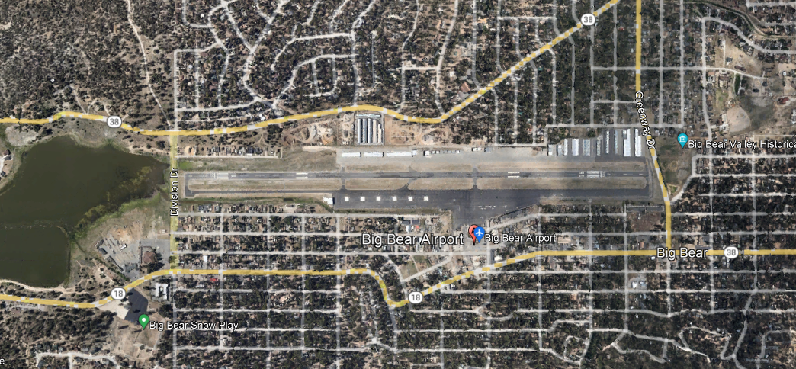

Big Bear City
Wind: see lake
Altitude: 6750 UNI/CTAF:122.725 AWOS: 135.925
8
26
Notes:
Valid Until: 3/21/2024

Slide 2
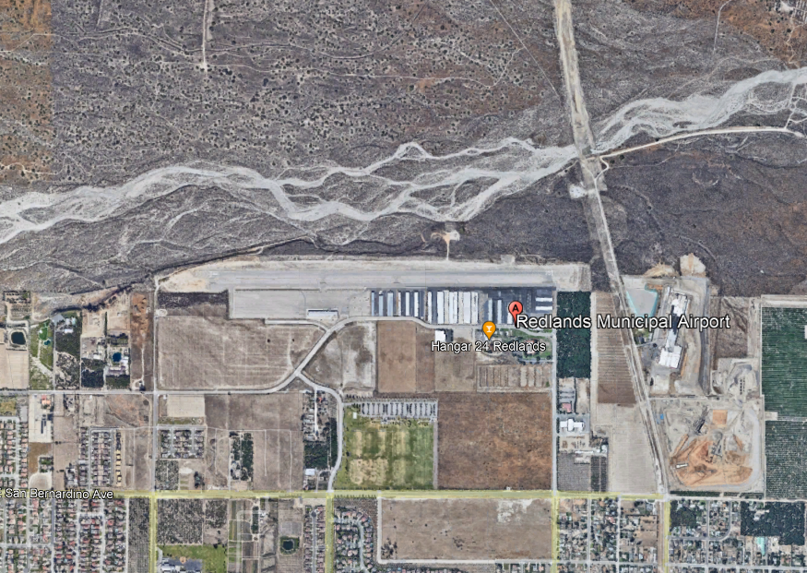
Redlands
Muni
Altitude:
1575
UNI/CTAF:
123.05
No wind: 8
8
26
Notes:
Valid Until: 3/21/2024

Slide 3
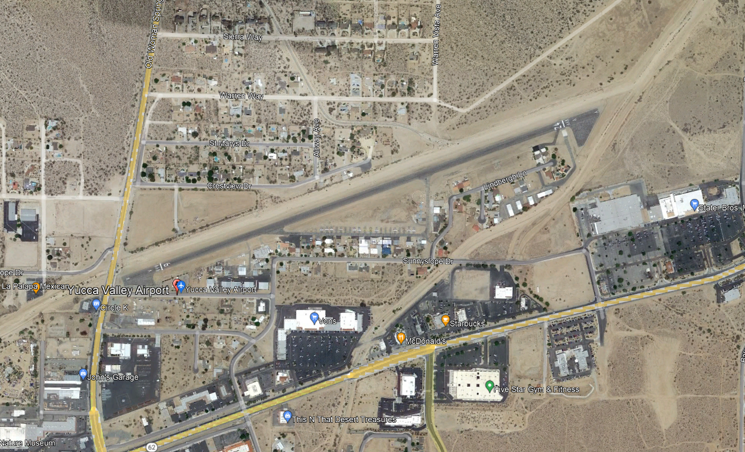
Yucca Valley
North of Hwy 62
24
Altitude: 3225
UNI/CTAF: 123.0
6
Notes:
Valid Until: 3/21/2024

Slide 4
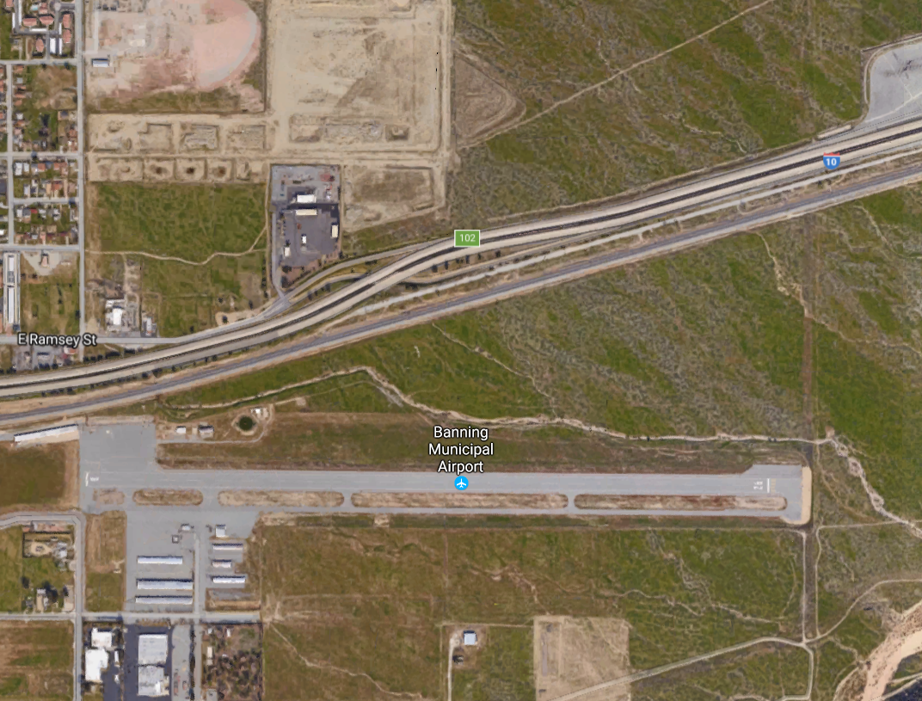
Banning
East Edge of town
Altitude: 2222
UNI/CTAF: 122.8
AWOS: 134.625
8
26
Notes:
Valid Until: 3/21/2024

Slide 5
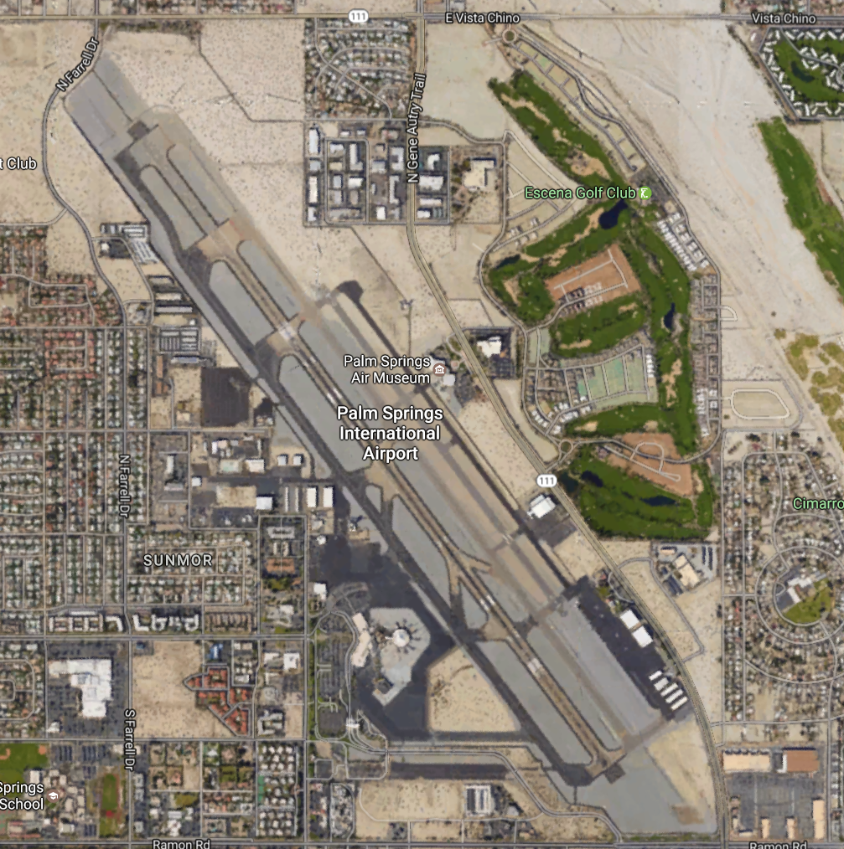
Palm Springs
13 R
13 L
Calm Winds use 13
Altitude: 476
CT: 119.7
Ground: 121.9
ATIS: 124.65
UNI: 122.95
P
31 R
31 L
Notes:
Valid Until: 3/21/2024

Slide 6
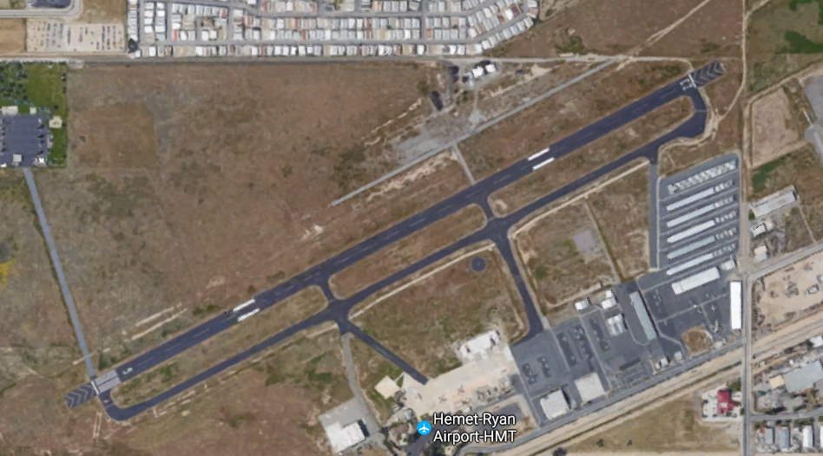
Hemet Ryan
Just NE of Diamond Lake
22
23
Altitude: 1515
Unicom CTAF
123.00
AWOS
118.375
4
5
Notes:
Valid Until: 3/21/2024

Slide 7
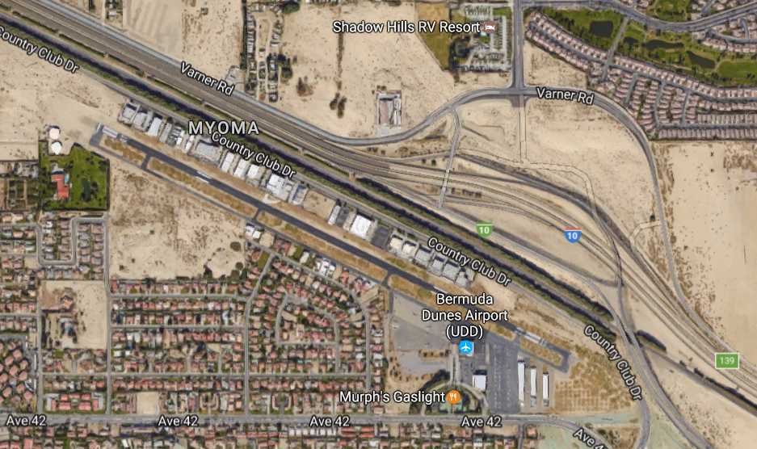
Bermuda
Dunes
10 miles SE of Palm Springs, adjacent to Hwy 10
20 miles NW of Salton Sea
10
Altitude: 73
UNI/CTAF: 122.8
ASOS(trm): 118.325
ATIS (psp): 124.65
28
Notes:
Valid Until: 3/21/2024

Slide 8
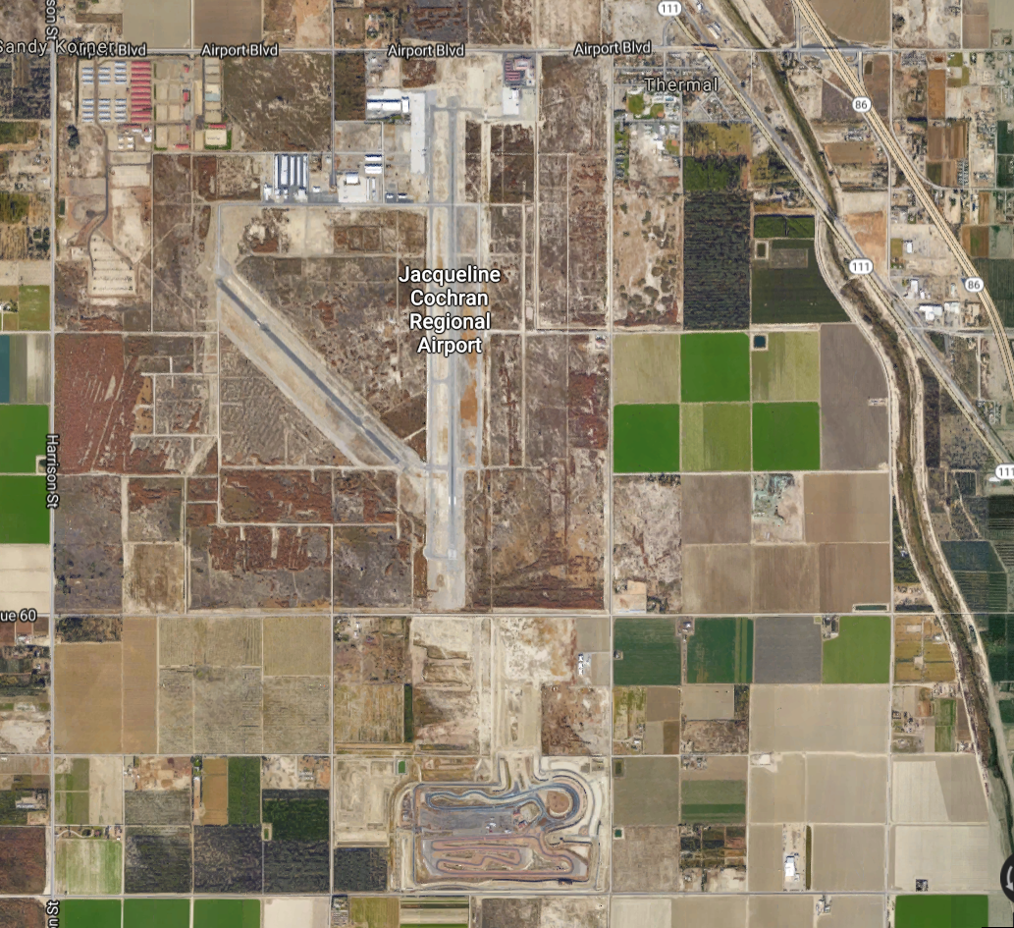
Thermal
17
12
20 mi SE of Palm Springs
10 mi NW of Salton Sea edge
30
Altitude: minus114
CTAF/UNI: 123.0
ASOS: 118.325
35
Notes:
Valid Until: 3/21/2024

Slide 9
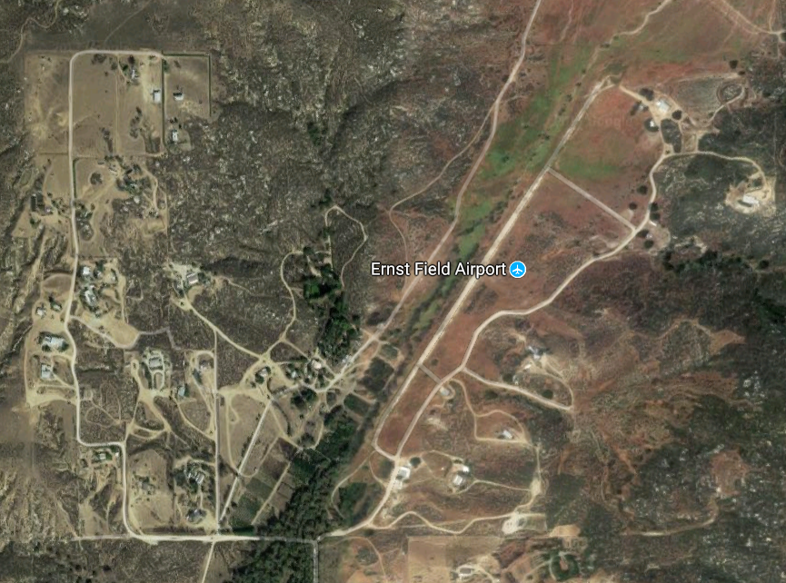
Ernst
Field
(Narrow, look for widest spot without bushes)
20
Between:
Diamond Valley Lake
Lake Riverside
Altitude: 2850
CTAF: 122.8/9
2
Notes:
Valid until ??

Slide 10
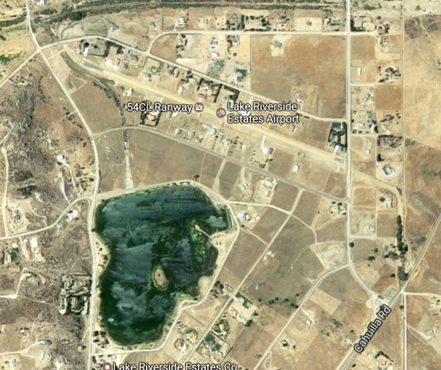
Lake Riverside
10
6 miles SW of Anza
Wind Direction: See Lake
Note: Wires (red dashes)
28
Altitude: 3410
CTAF: 122.8/9
Notes:
Valid

Slide 11
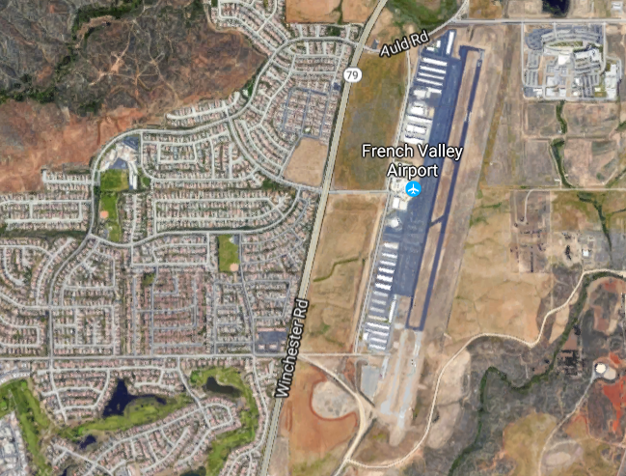
French
Valley
18
4 miles
WSW of Lake Skinner
P
Altitude: 1350
UNI/CTAF: 122.8
AWOS: 119.025
36
Notes:
Valid Until: 3/21/2024

Slide 12
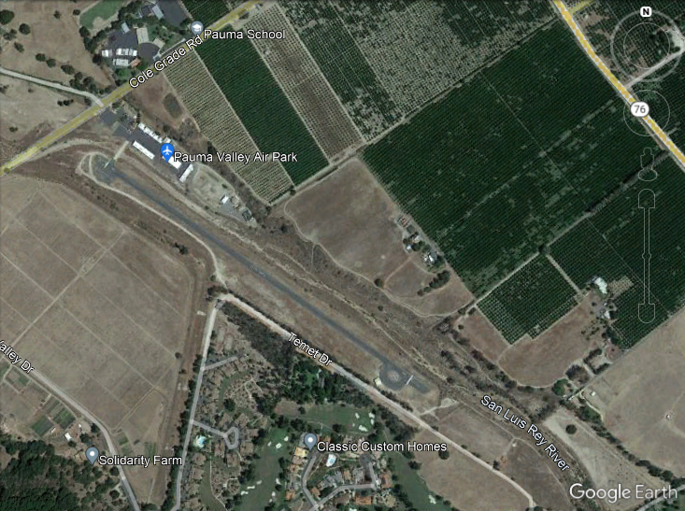
Pauma Valley
11
SE Corner
Cole Grade and 76
Altitude: 750
UNI: 122.725
29
Notes:
Valid Until: 3/21/2024

Slide 13
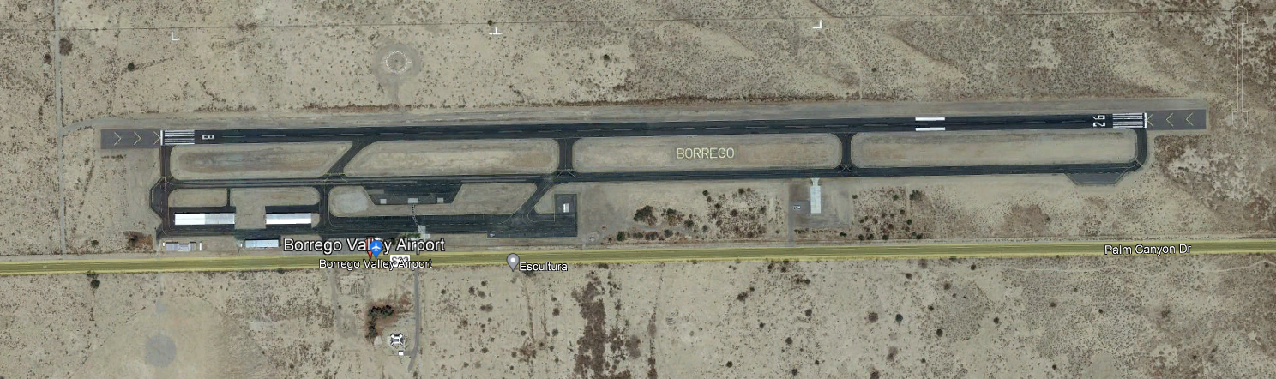
Borrego Valley
Altitude: 520
AWOS: 126.575
UNI/CTAF: 122.8
3 miles East of Town
26
8
Notes:
Valid Until: 3/21/2024

Slide 14
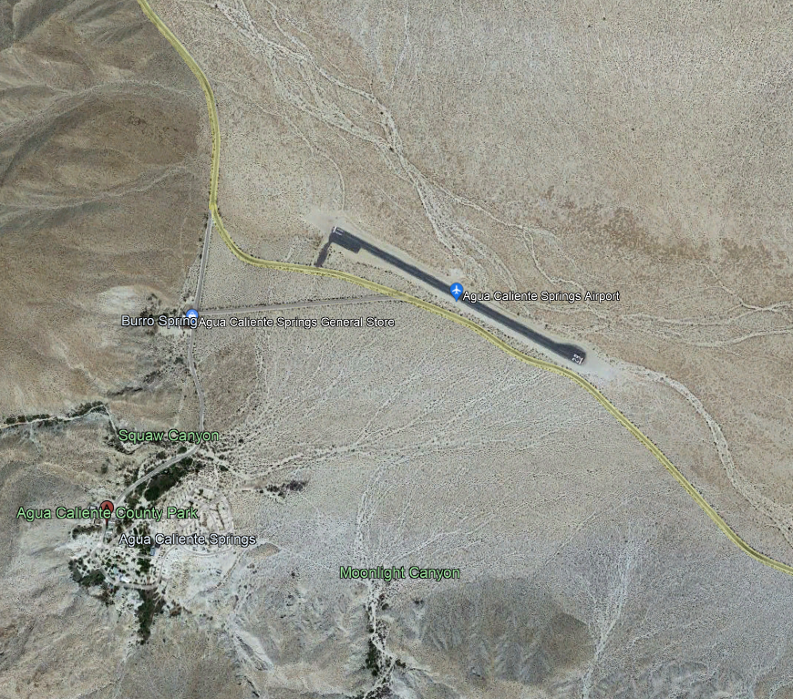
Agua Caliente
10 mi ENE of Mt. Laguna
(S2 between Scissors and Ocotillo)
11
29
Altitude: 1220
CTAF: 122.9
Notes:
Valid Until: 3/21/2024

Slide 15
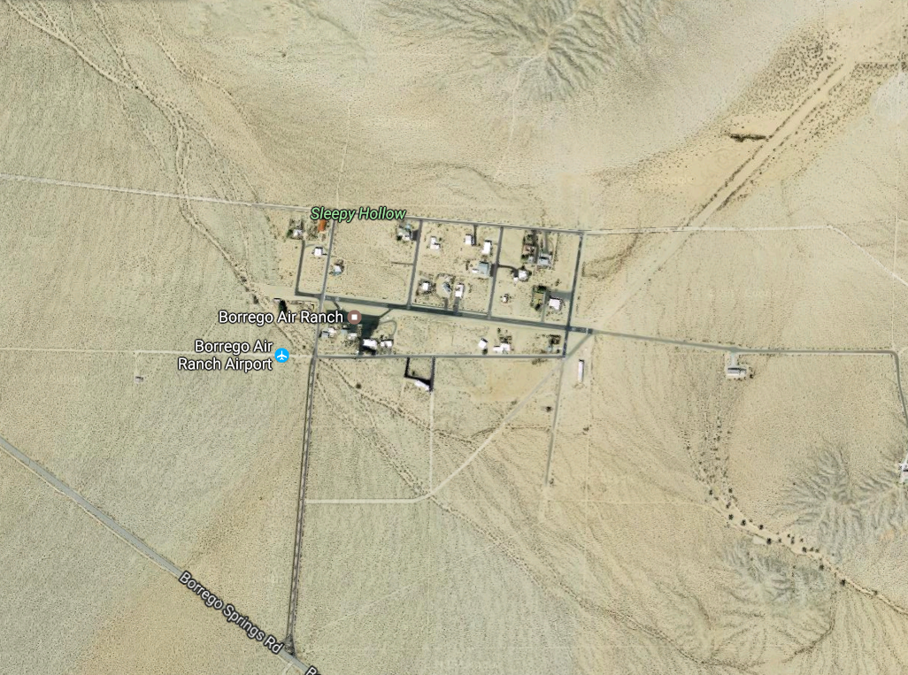
Borrego
Air
Ranch
(pvt)
8
26
4 mi SSE of
Borrego Valley
Altitude: 575
UNI: 122.8/9
Notes:
Valid

Slide 16
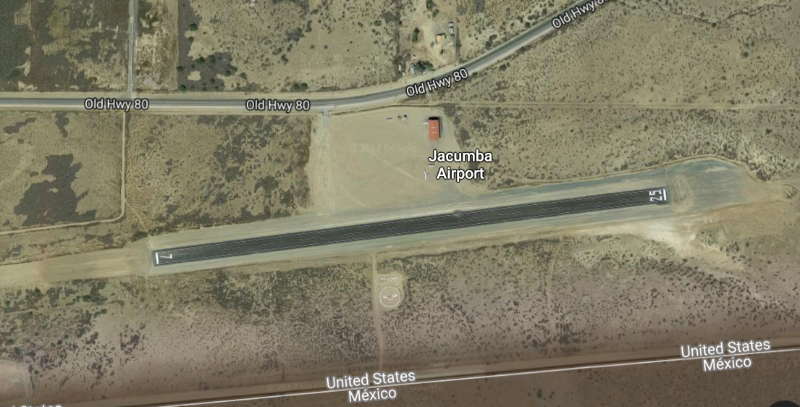
Jacumba
Altitude: 2850
CTAF: 122.9
25
7
Notes:
Valid Until: 3/21/2024

